Slide 1

Flight Price Prediction Model Project
Submitted By: NIHAL SINGH

Slide 2
Introduction:
The project is flight Pricing prediction model is basically use to predict the price of the flights running on different routes based on different criteria.
This model is basically build by scrapping the data from multiple websites using selenium automation tools.
Flight Price prediction model is used to predict the probability of the price for the flights for the different routes and timings.
The model is build by working on multiple models and finalizing the one best model after working on data.
For building the model performing data cleaning, EDA, data preprocessing, model building, hyper parameter tuning and saving the model.

Slide 3
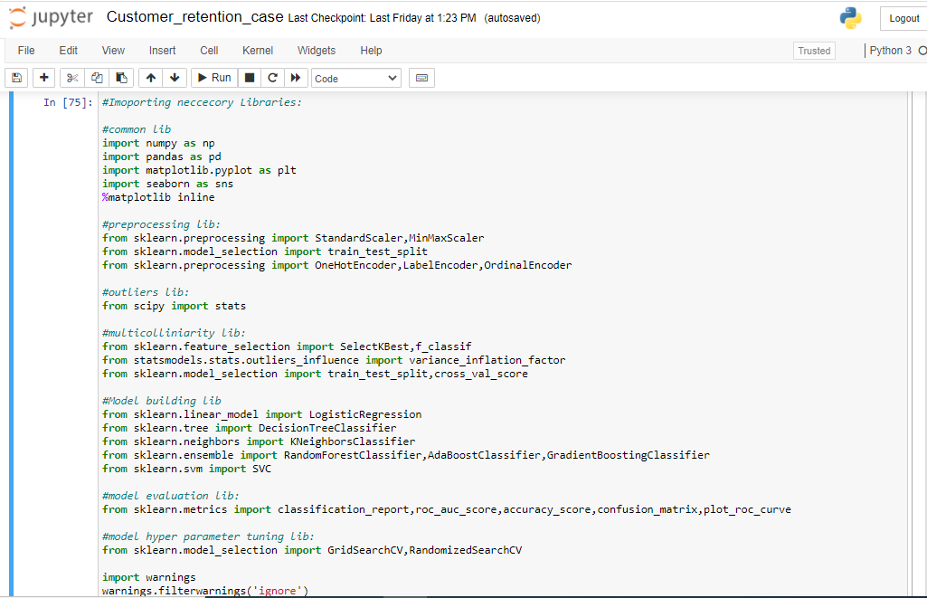
Importing Libraries:
Importing the Libraries used for EDA, data preprocessing and model building.

Slide 4
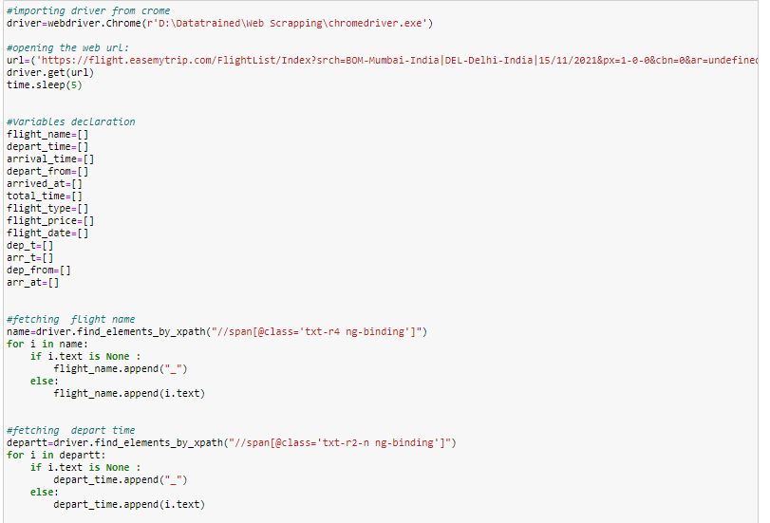
Using Selenium to fetch the Data:
Selenium Web driver is used to fetch the data from multiple web sites.

Slide 5
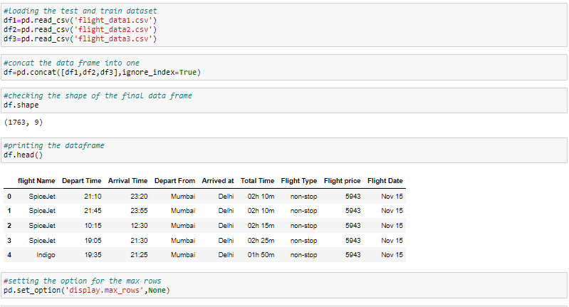
Fetching the Data frame:
Using the pandas library to import the data from csv file to data frame.
The library has been used read_csv.
There are six csv file so merging all the file for data preprocessing and perform the EDA.

Slide 6
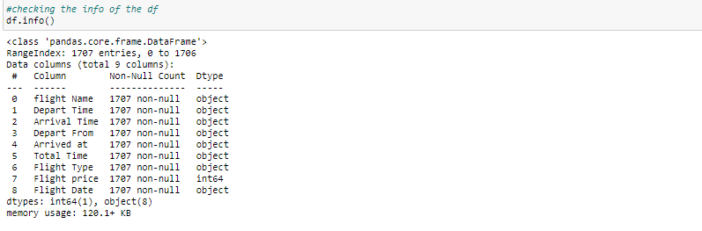
Checking the Shape and info of Data Frame:
Checking the shape of the Data frame using the .shape method.
The shape of the combined data frame is (5271,7).
Checking the datatype information about the data frame using the info method.

Slide 7
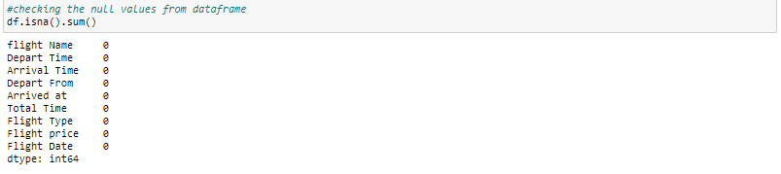
Checking the Null value count in Data frame:
Checking the null value count from every column of data frame.
Using the isnull().sum() method to check the null values. There is no null values in columns.

Slide 8
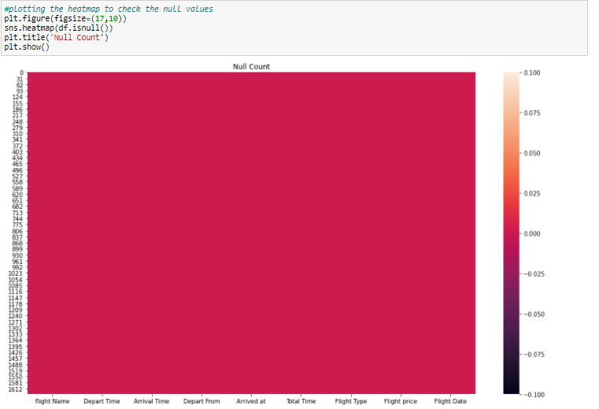
Checking the Null value using Heat map:
Checking the null value count from every column of data frame using the heat map.
Using the seaborn library and using the heat map from the library. There is no null values present in the given data frame.

Slide 9
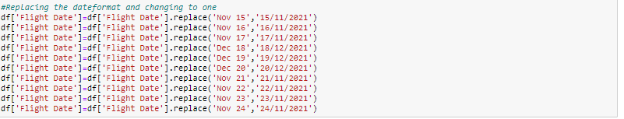
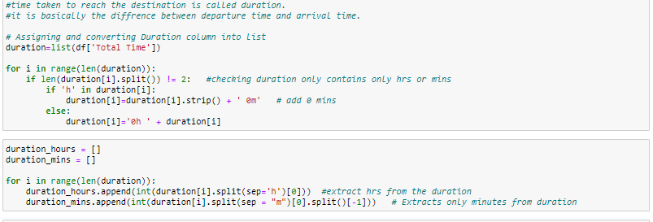
Replacing the values:
Replacing the date data with some proper data to perform the EDA.
Converting total time data with the numeric data to perform the EDA.

Slide 10
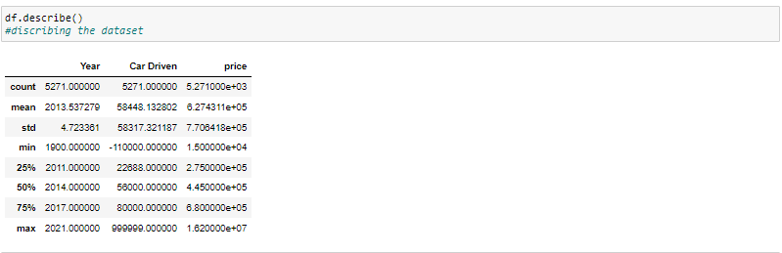
Using Describe Method to describe the data frame:
Using the describe method to describe the numerical columns.Describe method
only work on the numerical data features.
Describe is basically provide the count,mean,standered deviation,min max and quantile details of the columns data.it can be display using df.describe().

Slide 11
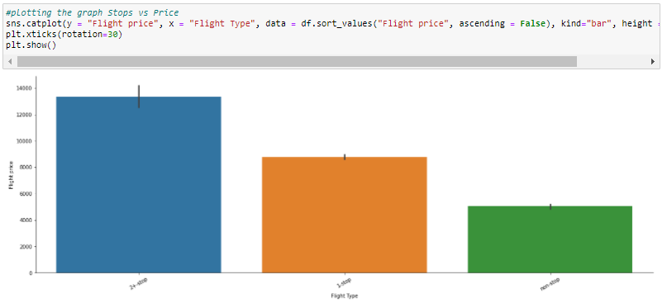
Plotting the Bar Plot:
Using the Cat plot to plot the graph for flight type vs flight price .
The Bar plot shows the flight price is higher for more than 2 plus stops .

Slide 12
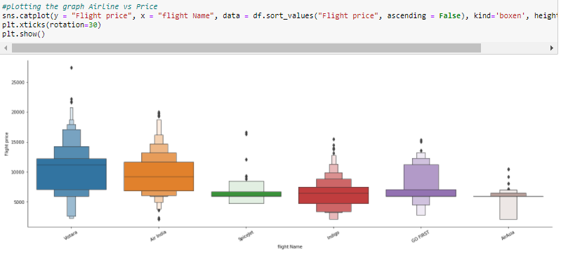
Plotting the Cat Plot:
Using the Cat plot to plot the graph for Flight name vs flight price.
The cat plot shows the flight price is higher for Vistara flight.

Slide 13
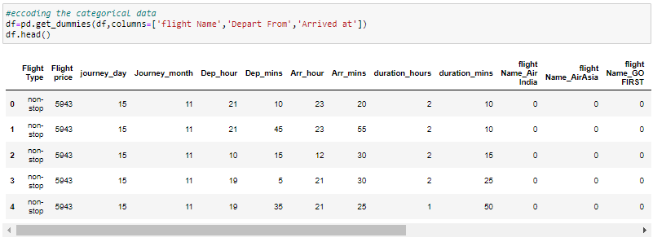
Using the Encoder to encode the categorical data:
For more than 2 values use get_dummies to encode the categorical data to numerical data.

Slide 14
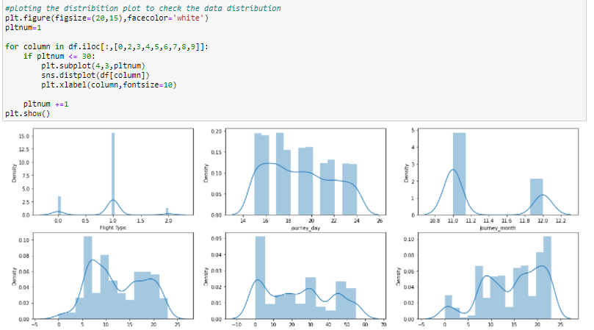
Plotting the Distribution Plot:
After performing the data cleaning and describe the data plotting the dist plot to check the data distribution.

Slide 15
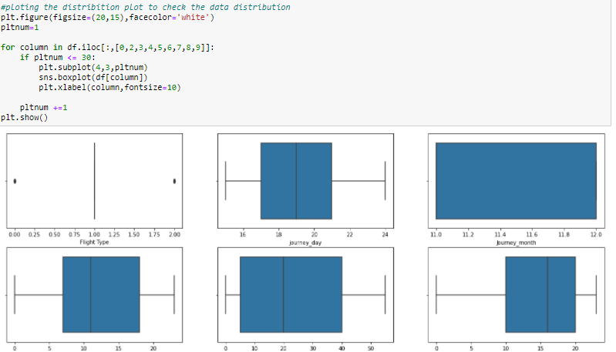
Plotting the Box Plot:
Using box plot to check the outliers in the features of the dataframe.outliers can be easily visible by using the box plot.
The Black dotted lines are the outliers present in some of the features.

Slide 16
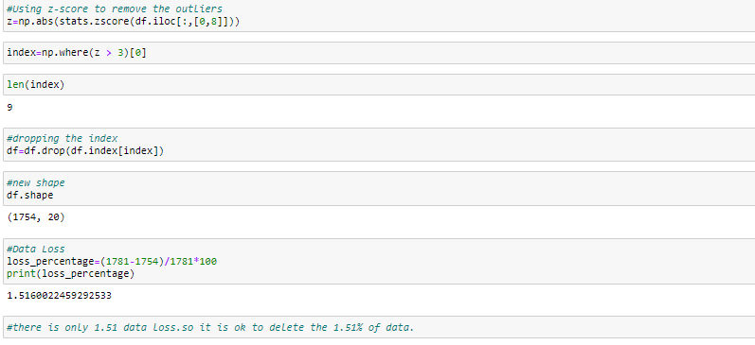
Removing Outliers using IQR:
There are multiple option to check the outliers and then delete the outliers.
The most commonly used method is z-score, IQR and quantile method. For this model using the IQR method.
The 1.51% data has loss after removing the outliers from the data frame.

Slide 17
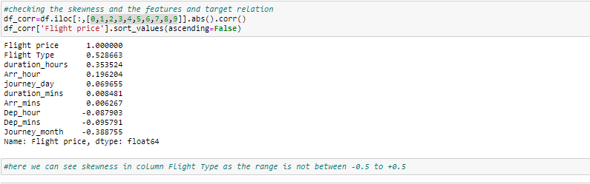
Skewness Removal:
After removal of the outliers, skewness is very important to check and if skewness is present then removal of the skewness.
Max times removal to outliers is automatically remove the skewness in the data.
The range of the skewness is -0.5 to +0.5,if the values are between that then there is skewness available on column flight type. Here we can see some skewness in the features.

Slide 18
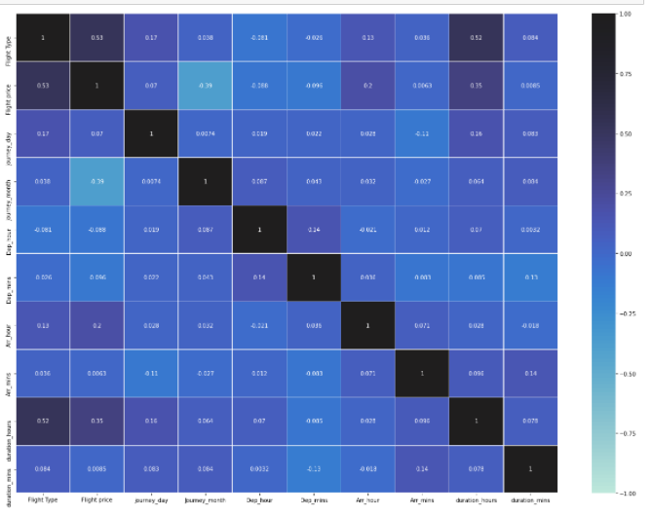
Checking Multicolliniarity Using Heat map:
Multicolliniarity is a problem for a model building.it shows relation between feature to feature. If the score is high then the features are highly collinear to each other.
Checking the multicolliniarity problem using heat map.
There is no multicolliniarity issue in the features.

Slide 19
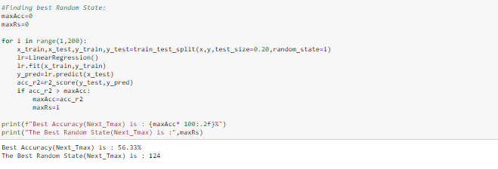
Training the model and finding the best random state:
After the EDA and data preprocessing training the model and finding the best random state using the train test split.
The training the model into x_train, y_train, x_test and y_test.

Slide 20
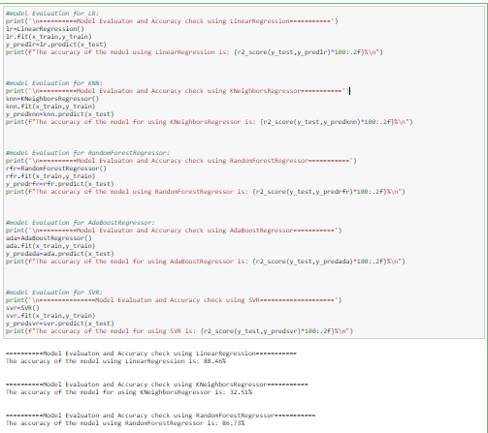
Building the multiple Models:
After the test_train_split, building the model using the test data.
Building all the classification models like Linear Regression , KNeighborsRegressor, AdaBoostRegressor, RandomForestRegressor, SVR.
Training all the classification on train and test data and finding the r2_score.

Slide 21
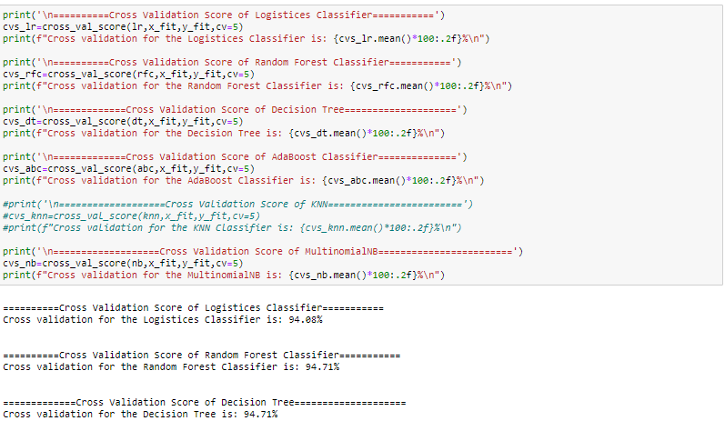
Performing Cross validation score:
After building the multiple models and getting the accuracy performing the cross validation score on all the models.
Cross validation is basically used to check the model is under fitting or over fitting on the test data.

Slide 22
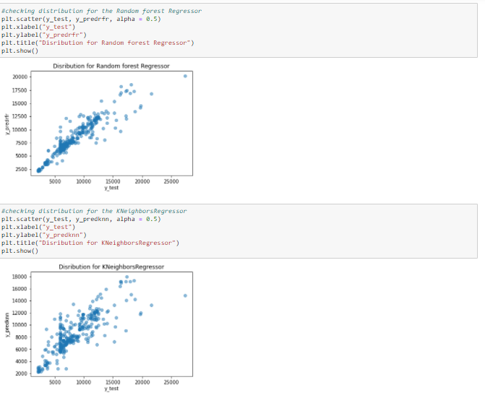
Plotting the Scatter plot after model building:
Plotting the scatter plot after the model building to check the plot of y_test vs y_perd for different models.

Slide 23
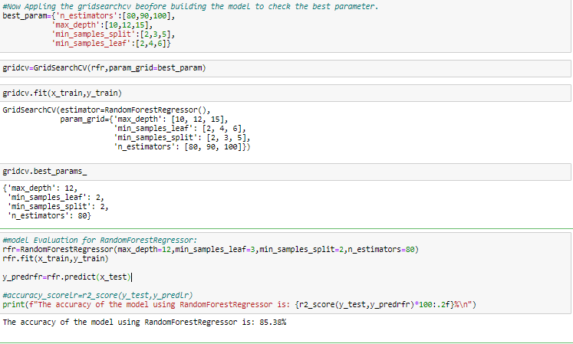
Hyper Parameter Tuning:
Selecting Random forest Regressor as a best model as it has highest score and least difference between r2_score and cross validation score.
Hyper parameter tuning having multiple parameters and selecting the best parameter for the model.

Slide 24
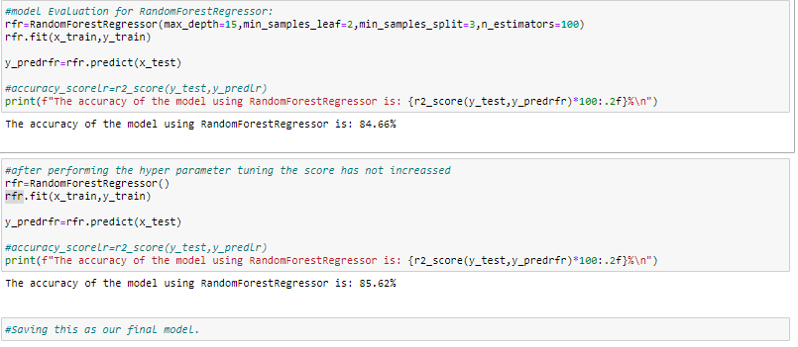
Training the model after Hyper parameter tuning:
Training the model again after the hyper parameter tuning and providing the best parameter values to the model gets from the hyper parameter tuning.

Slide 25
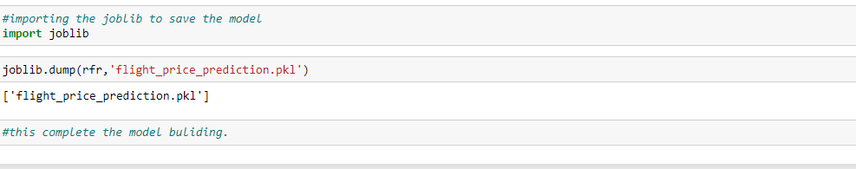
Saving the Model:
After the hyper parameter tuning saving the final model in the pkl file.
This complete the model building.

